Slide 1


Personal Bank Loan Analysis
Team 23
Rashmi Gehi, Sarah Guo, Tushar Pandey, Ahmet Tas, Alexandra Wang

Slide 2
Agenda
Model Estimation and Evaluation
Exploratory Data Analysis
Data Explanation
Managarial Takeaways
Introduction
Limitations

Slide 3

Introduction
Customers
Value of our Model
To Banks’ Understanding
- create valuable insights regarding customer segmentation and targeted marketing
Borrowers
Liability Customers
To Banks’ Actions
- capitalize on potential borrowers and work to increase marketing efforts towards them
Profit
Goal
To increase the number of borrowers through marketing campaigns
To Us
- understand the ways banks may implement marketing campaigns toward us

Slide 4
Data Explanation

Slide 5


Data Explanation
Demographic Data
Financial Data
Customer ID
Age (in years)
Experience (in years)
Income (in thousands of dollars)
Family size
Education Level (Undergrad, Grad, Advanced)
Mortgage (in thousands of dollars)
ZIP Code
Monthly average Credit Card Spend
Securities Account (0/1 flag)
Certificate of Deposit Account (0/1 flag)
Online Bank Services (0/1 flag)
Credit Card (0/1 flag)
Personal Loan (0/1 flag)
5000 bank customers with 14 variables

Slide 6
Exploratory Data Analysis

Slide 7
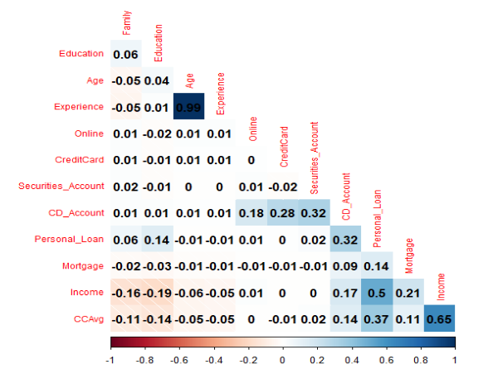
We started off by analyzing the correlation between numerical variables
Age & Experience
99%
Income & CCAvg
65%
Check the distribution of
Age
Family size
Personal loans
Education level
Region

Slide 8
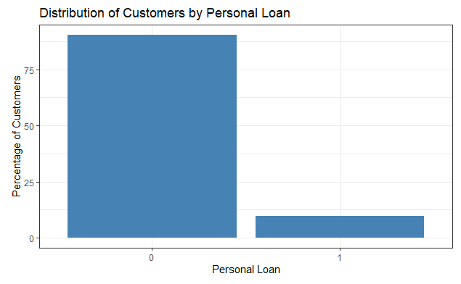
The dataset is highly left-skewed in terms of people who accept personal loan offers
90% of the customers do not accept personal loans

Slide 9
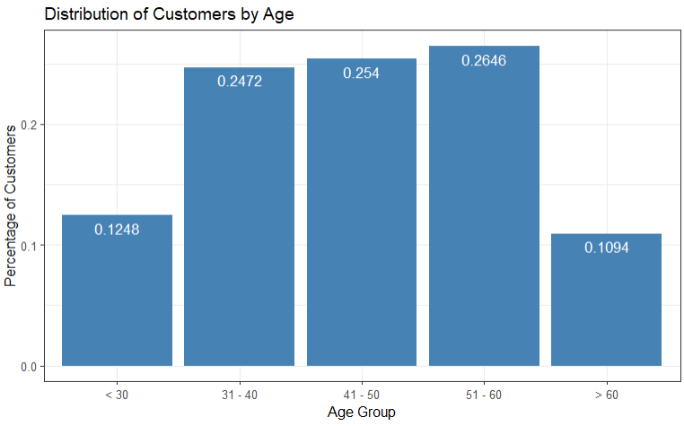
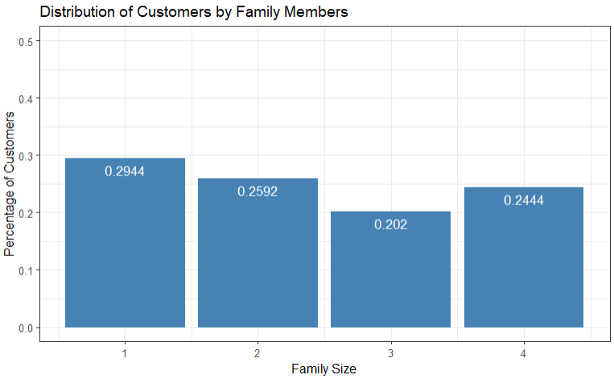
The dataset contains a fairly equal distribution of young-single customers and older-married customers

Slide 10
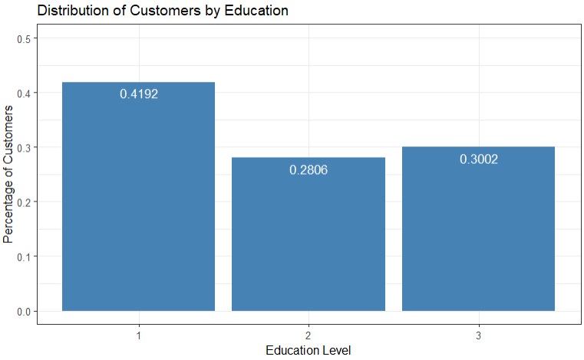
All customers at least have undergraduate degrees

Slide 11
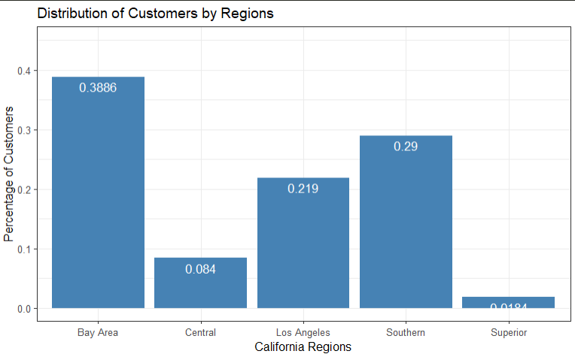
The most populous region is the Bay Area with 1943 customers, followed by the Southern region with 1450 customers

Slide 12
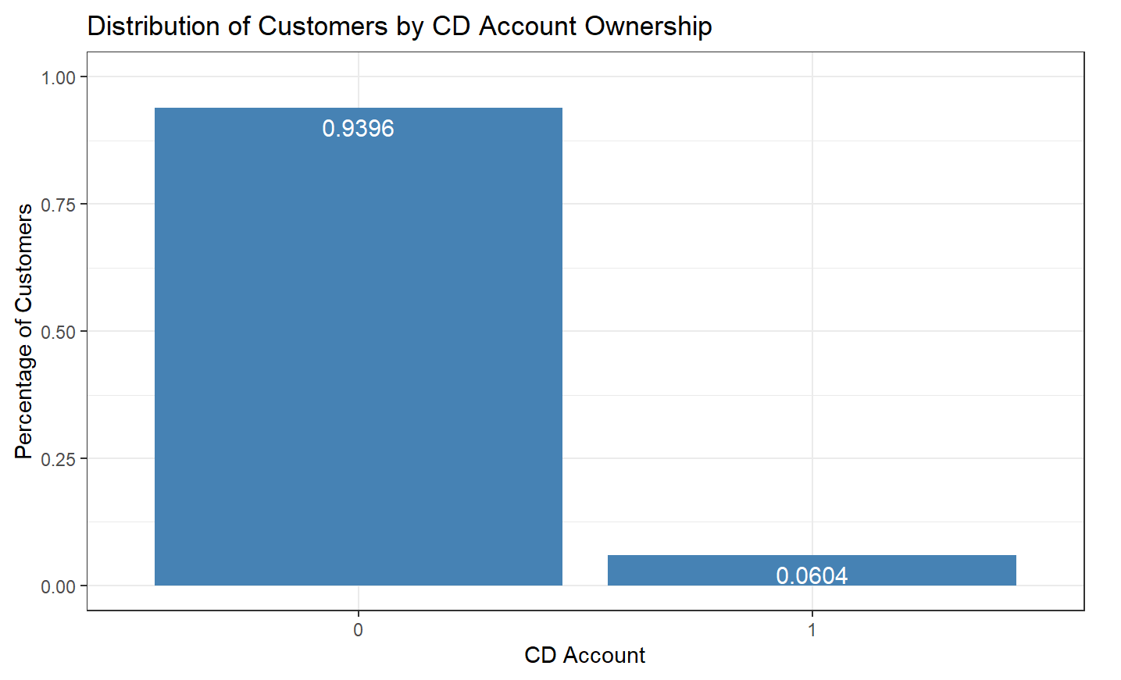
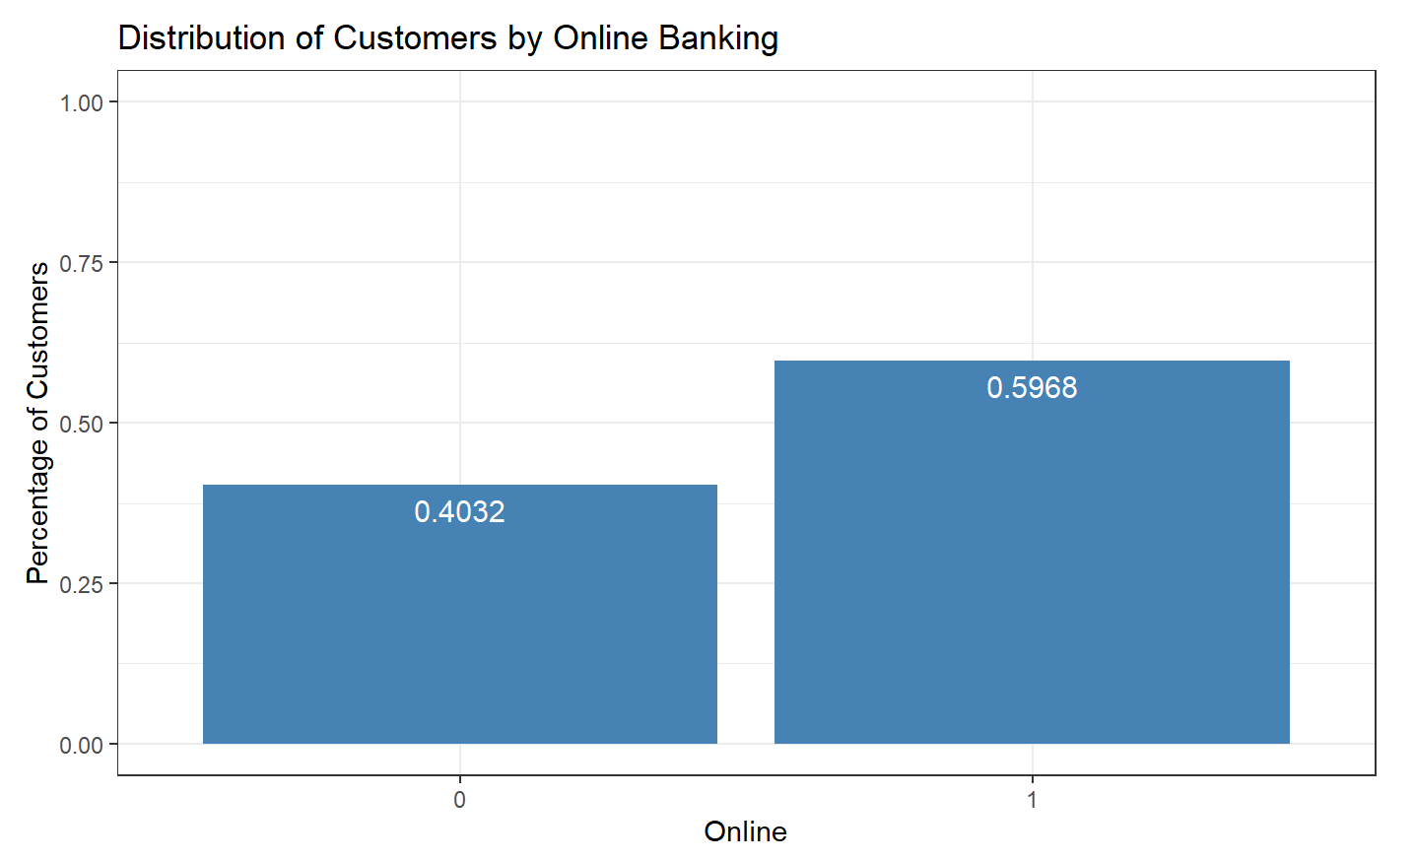
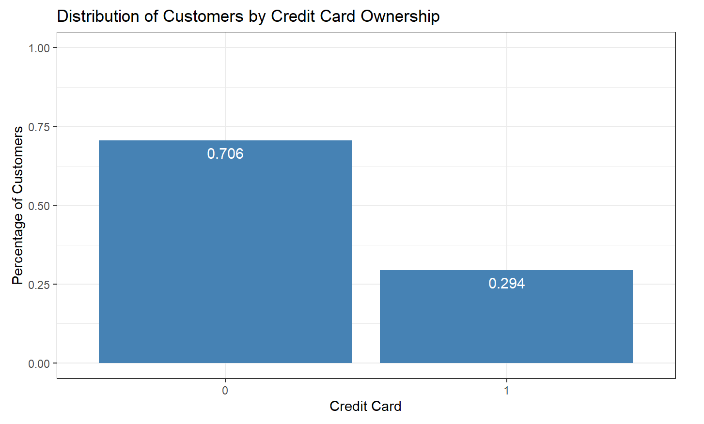
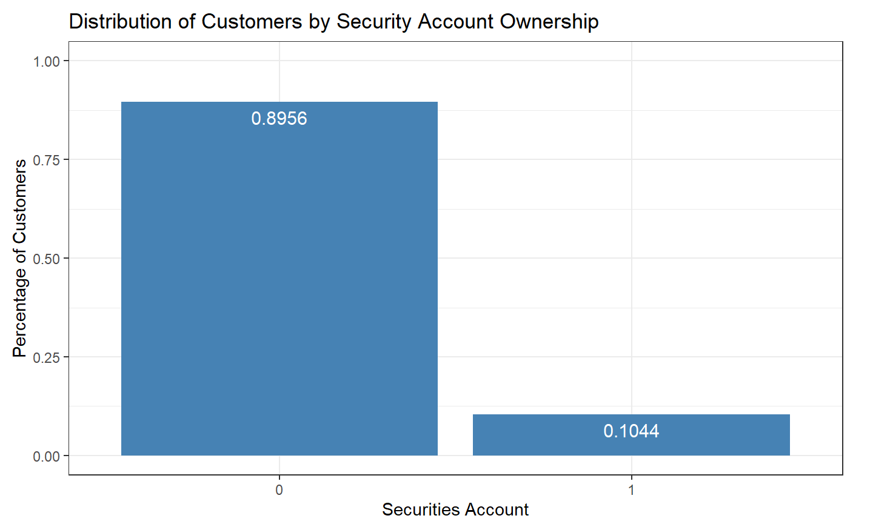
Customers engage in a variety of banking operations

Slide 13
Model Estimation & Results
Unsupervised Machine Learning

Slide 14
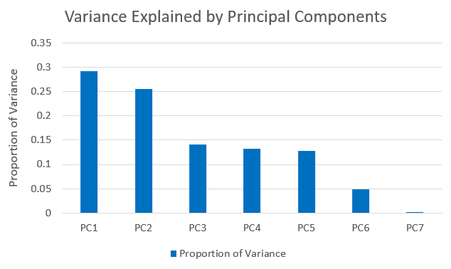
We used Principal Component Analysis on the numerical data to understand the data better
The first three principal components explain ~70% of the dataset
Older people with high experience
Young people with low income
Families who have a mortgage

Slide 15
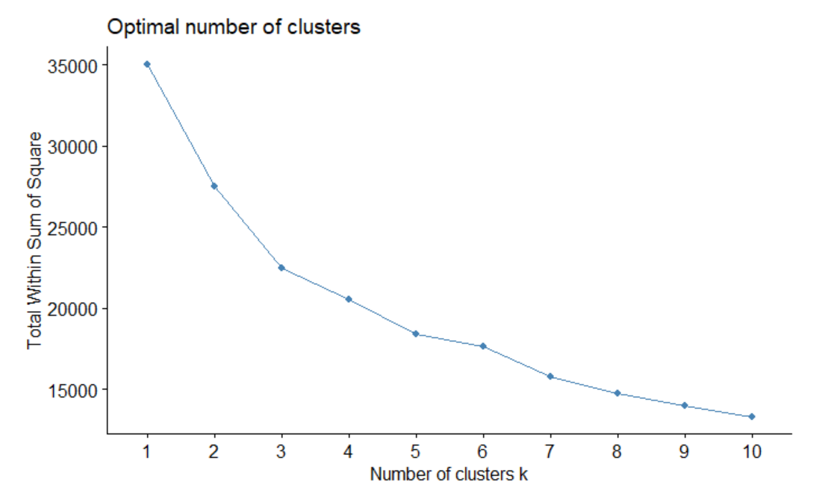
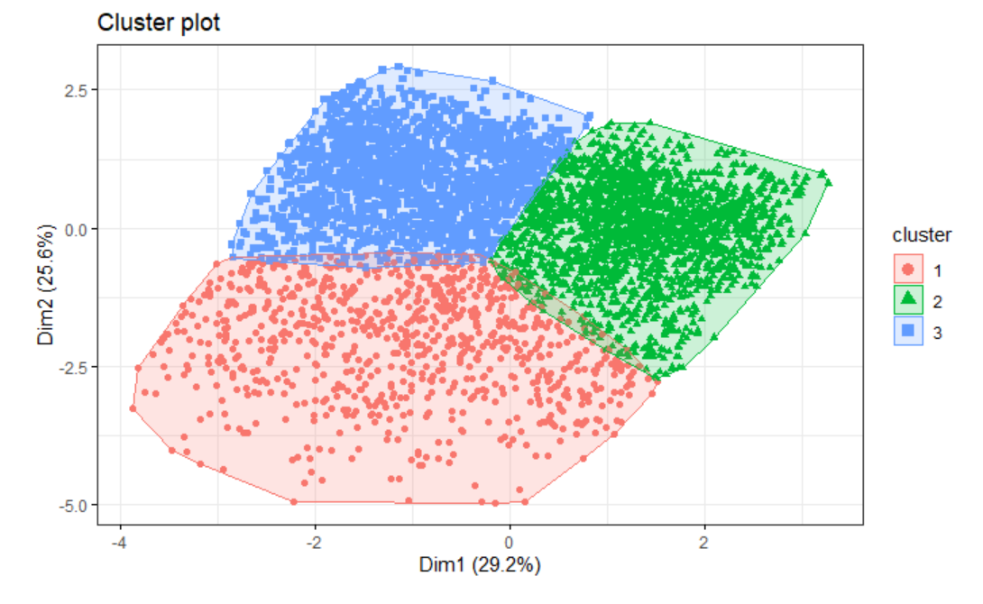
Using k-means clustering, we were able to identify three clusters with distinct behaviors
Cluster 1: Loyalists
(859 customers)
Cluster 2: Samplers
(2132 customers)
Cluster 3: Potentials
(2009 customers)

Slide 16
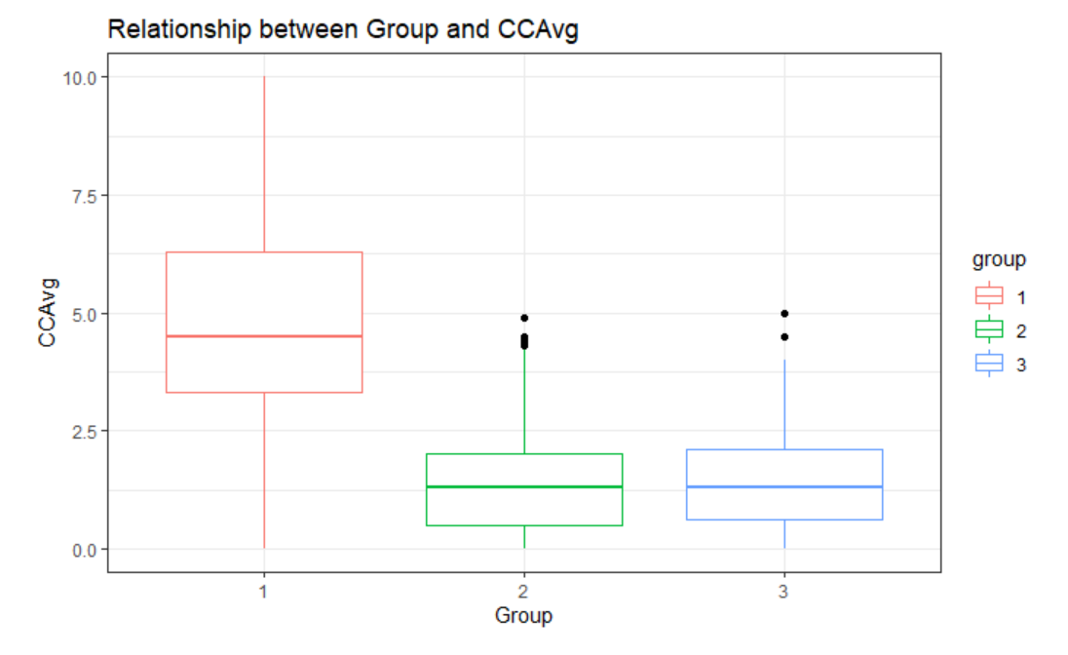
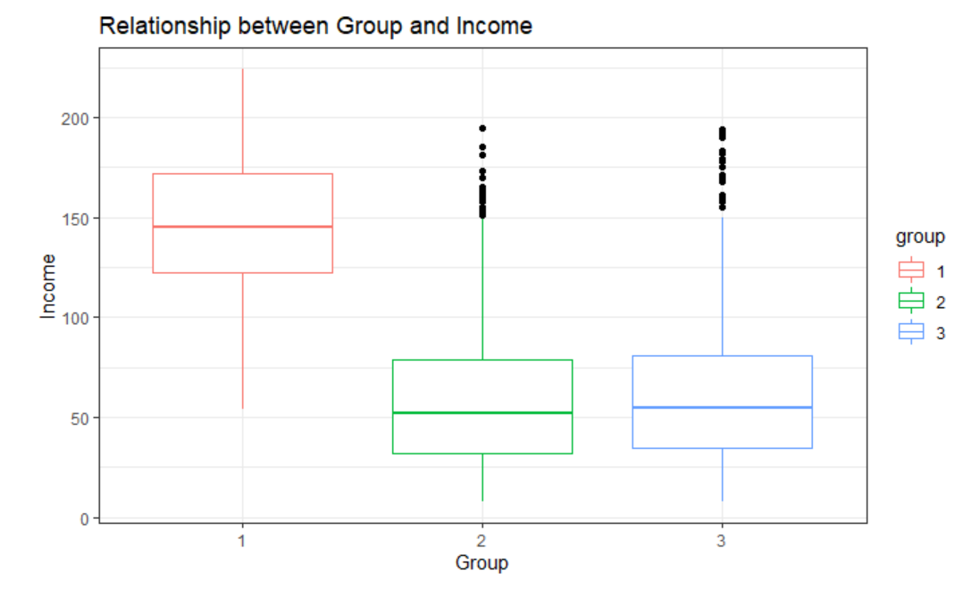


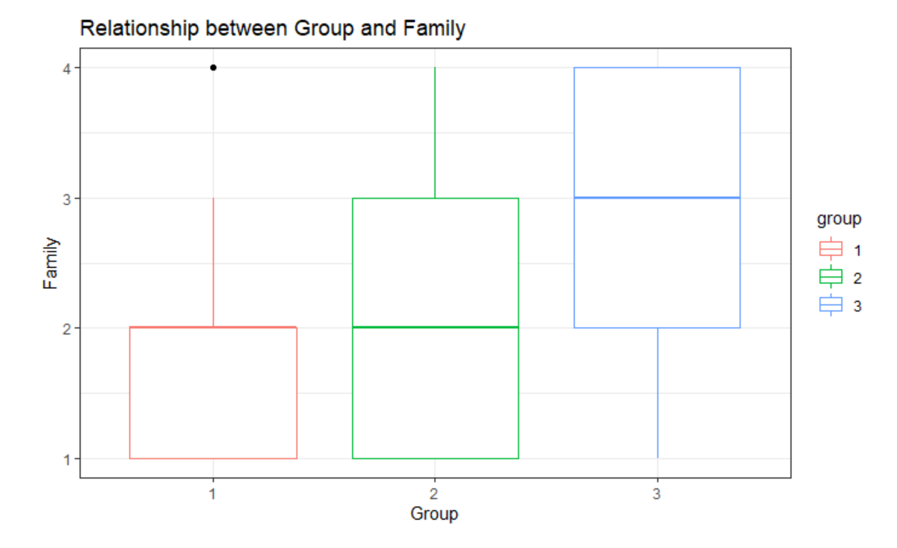


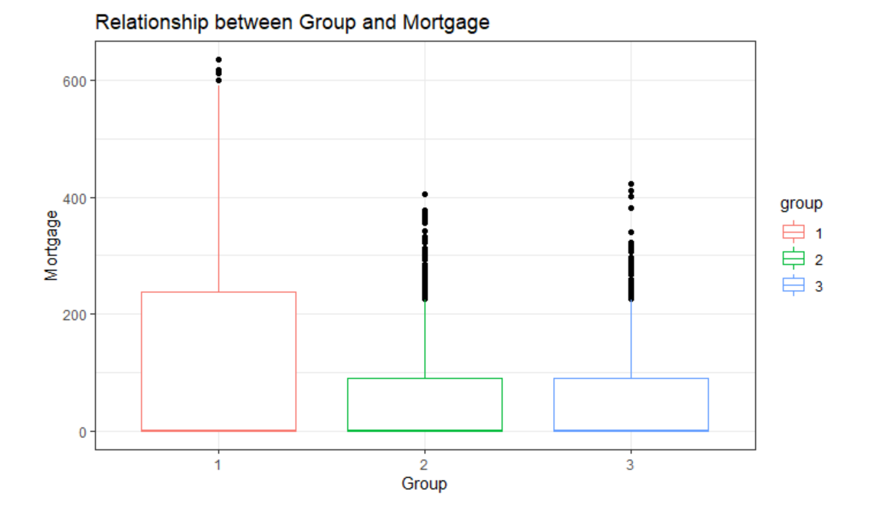
Cluster 1 consists of high-income, high-spending couples with a mortgage
Variables

Slide 17
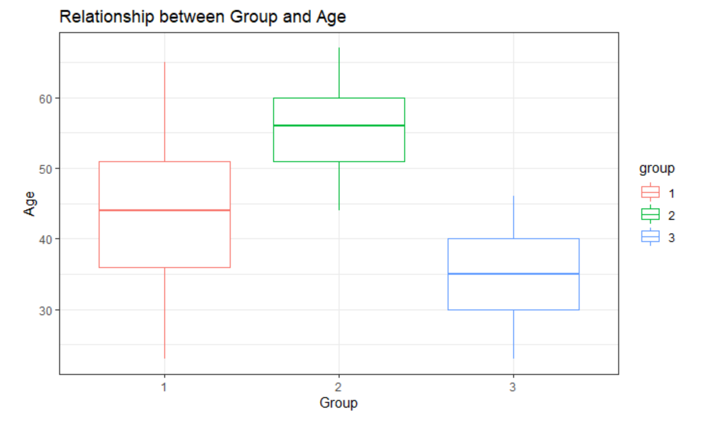

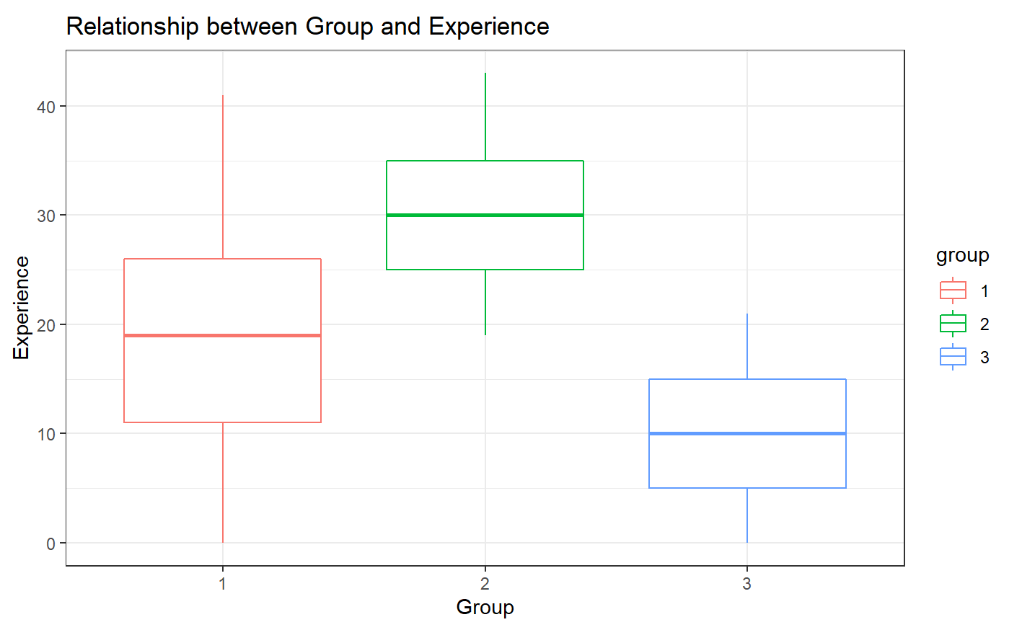

Cluster 2 consists of older families with lots of work experience
Variables

Slide 18
Cluster 3 consists of young families with less work experience and income
Variables

Slide 19
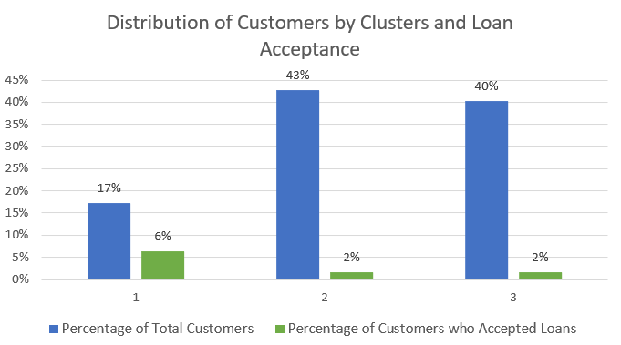
Although Cluster 1 is the smallest group of customers, they have the highest acceptance rate of loans

Slide 20
Model Estimation and Results
Supervised Machine Learning

Slide 21



To help bank managers predict whether a customer would accept a loan offer, we employed supervised machine learning models
Model Formulation & Estimation
Model Evaluation & Calibration
Model Interpretation & Results
Design a logistic regression model to predict whether a customer would accept a loan offer or not
Evaluate different performance metrics to check model fit and accuracy
Calibrate existing model to improve prediction results
Interpret and quantify final model results

Slide 22
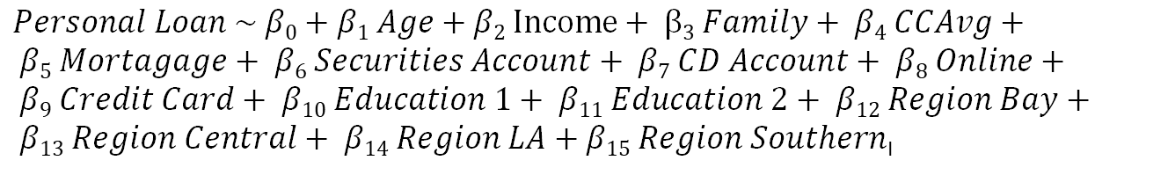
Model 1: In the first model, we decided to run Personal_Loan with all independent variables
Model Data
Training Data Set → 80%
Testing Data Set → 20%
Target Variable → Personal_Loan (Binary Variable)
Model Estimation
$Personal Loan \sim β0+β1 Age+β2 Income+ β3 Family+ β4 CCAvg+ β5 Mortagage+ β6 Securities Account+ β7 CD Account+ β8 Online+ β9 Credit Card+ β10 Education 1+ β11 Education 2+ β12 Region Bay+ β13 Region Central+ β14 Region LA+β15 Region Southern$_{I}
Model Performance
Out-of-sample Accuracy = 0.96
Out-of-sample R-Squared = 0.53

Slide 23


Model 1: Although this model performs has good performance, the false negative rate of the model is high
Train Data |  |  |  | Test Data
 | Predicted 0 | Predicted 1 |  |  | Predicted 0 | Predicted 1
Observed 0 | 3129 | 35 |  | Observed 0 | 1340 | 16
Observed 1 | 114 | 222 |  | Observed 1 | 44 | 100
The false negative customers as those customers whom the model predicts would not accept the loan offer when they actually accept
False negatives are important customers that the model incorrectly predicts, but these customers are missed opportunities that the marketing team of the bank would lose out on if not targeted

Slide 24
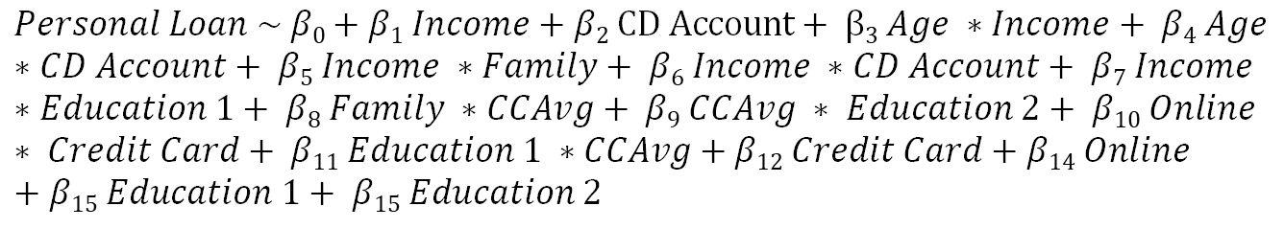
Model 2: Removing statistically insignificant variables and adding interaction terms to predict Personal_Loan
Model Data
Training Data Set → 80%
Testing Data Set → 20%
Target Variable → Personal_Loan (Binary Variable)
Model Estimation
$$Personal Loan \sim β0+β1 Income+β2 CD Account+ β3 Age ∗Income+ β4 Age ∗CD Account+ β5 Income ∗Family+ β6 Income ∗CD Account+ β7 Income ∗Education 1+ β8 Family ∗CCAvg+ β9 CCAvg ∗ Education 2+ β10 Online ∗ Credit Card+ β11 Education 1 ∗CCAvg+β12 Credit Card+β14 Online+β15 Education 1+ β15 Education 2$$
We used Lasso Regression to identify the most important interaction that has the highest impact on the log(odds) of Personal_Loan = 1
Model Performance
Out-of-sample Accuracy = 0.97 ( + 0.01 compared to Model 1)
Out-of-sample R-Squared = 0.73 ( + 0.20 compared to Model 1)

Slide 25
Model 2: Introducing interaction terms significantly reduced the percentage of false negatives
Train Data |  |  |  | Test Data
 | Predicted 0 | Predicted 1 |  |  | Predicted 0 | Predicted 1
Observed 0 | 3139 (+10) | 25 (-10) |  | Observed 0 | 1342 (+2) | 14 (-2)
Observed 1 | 55 (-59) | 281 (59) |  | Observed 1 | 21 (-23) | 123 (+23)
Model 2 reduced the number of false negatives by 59 customers in the training set and 23 customers in the test set.

Slide 26
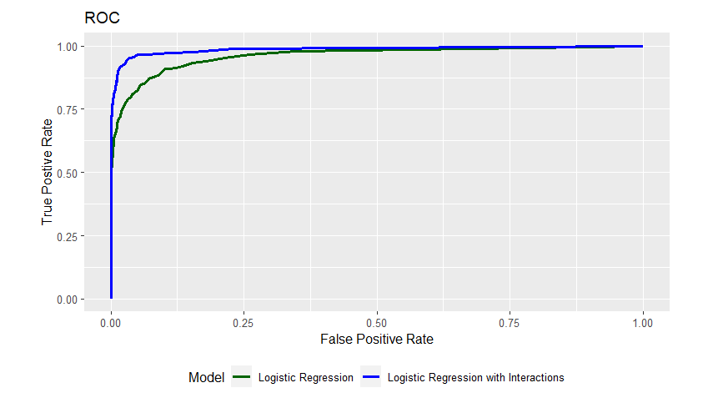
Model 2 also performs better in terms of ROC as compared to Model 1

Slide 27
Model 2 has 13 statistically significant variables, which all have a p-value of <0.05
Key Insights
For a one-unit increase in income, the odds of loan acceptance increase by the largest amount
Followed by Income*Family size, Credit Card spending, Education level (undergrad), and the presence of a CD account
For a one-unit increase in Family size, the odds of loan acceptance decrease by a small amount
This is followed by online users, credit card owners, low-income and lower-education customers
Variable | Coefficient | Odds Ratio
Income | 5.19 | 179.58
Income:Family | 1.79 | 5.99
CCAvg | 1.53 | 4.60
Education_1 | 1.01 | 2.76
CD_Account | 1.00 | 2.73
Family:CCAvg | 0.52 | 1.69
CCAvg:Education_2 | 0.51 | 1.67
Family | -0.50 | 0.61
Online | -0.57 | 0.57
Online:CreditCard | -0.67 | 0.51
Education_1:CCAvg | -0.88 | 0.42
CreditCard | -0.88 | 0.41
Income:Education_1 | -2.92 | 0.05
Decreasing order of Coefficient
These are mainly high-income families that are well educated
These are mainly young singles that have credit cards and lower education levels

Slide 28
Managerial Takeaways

Slide 29
Bank managers can target clusters with varying products based on their unique characteristics
Loyalists
Samplers
Potentials
- High income, high spending couples with mortgages
Mid age Customers with highest conversion rate.
Best suited for cross-selling
Personalized offers through emails, and calls can result in lower cost conversion rates
- Older families with lots of work experience
Old age customers with
lower conversion rate for loans.
Can be considered for securities accounts at bank.
Least marketing budget allotment keeping CLV in consideration
- Young families with less work experience and income
Middle-aged customers with high education and low conversion rate.
This is the potential customer cluster who can accept loan if marketed well.
Would allot maximum marketing budget to target segment.

Slide 30



Bank managers can also target customers for personal loans specifically based on the logistic regression models
New User Acquisition
With our prediction model, we can predict the probability that a customer who will accept the loan with 97% accuracy. This model can be used on all new customer registration.
Promotional Budget
The features that are dominant in the logistic regression tells us that customers with higher income, with good credit history and have families have higher chance of accepting the loan. We can target them with promotional offers to maximize chances of conversion.
User Retention
Once we identify the high potential customers through our logistic regression model, we can push them to use different services provided by the firm like securities, CD accounts and Credit Card offers. Helps manage marketing budget and higher retention rates.

Slide 31
Limitations

Slide 32
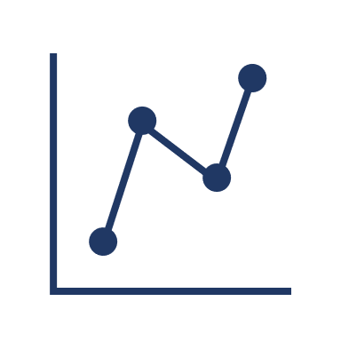


We see limitations due to our dataset, location factor and some exceptional circumstances.
Dataset
Our dataset is very skewed. Only 10% of the customers accept loans
Location
Exceptional Cases
Since our dataset is only for California, it may vary across the country
Our model may not apply to exceptional situations (a customer with low income and no education might get a loan)

Slide 33
Appendix

Slide 34
Box plots of Cluster Analysis

Slide 35
Box plots of Cluster Analysis

Slide 36
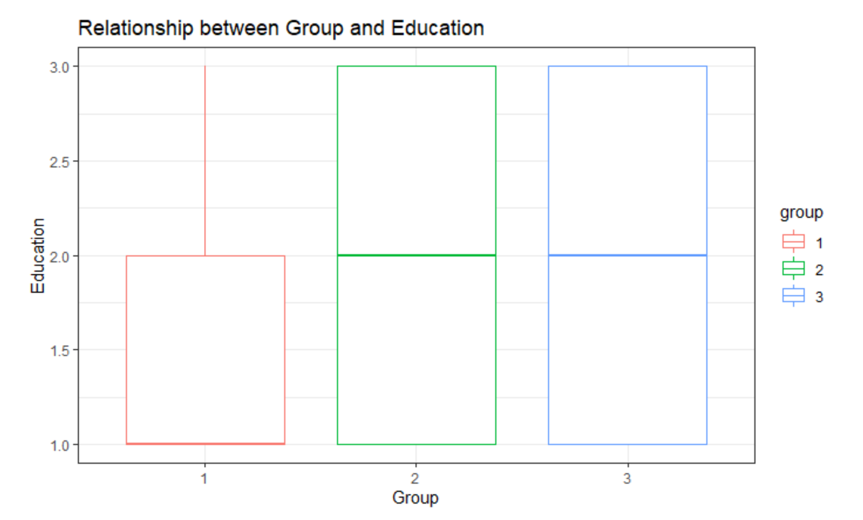
Box plots of Cluster Analysis

Slide 37
Model 2: We improved on the
Model Data
Training Data Set → 80%
Testing Data Set → 20%
Target Variable → Personal_Loan (Binary Variable)
Model Estimation
$Personal Loan \sim β0+β1 Age+β2 Income+ β3 Family+ β4 CCAvg+ β5 Mortagage+ β6 Securities Account+ β7 CD Account+ β8 Online+ β9 Credit Card+ β10 Education 1+ β11 Education 2+ β12 Region Bay+ β13 Region Central+ β14 Region LA+β15 Region Southern$_{I}
Model Performance
Out-of-sample Accuracy = 0.96
Out-of-sample R-Squared = 0.53

Slide 38
Bank managers can also target customers for personal loans specifically based on the logistic regression models
New User Acquisition
With our prediction model, we can predict the probability of a customer who will accept the loan with 97% accuracy. This model can be used on all the new customer registration.
Promotional Budget
Once the consumers are identified who need loan and have higher chance of conversion. We can save our marketing budget from targeting everyone and instead provide the high potential customers to ensure higher CLV, acceptance and retention.
User Retention
Once we identify the high potential customers through our logistic regression model, we can push them to use different services provided by the firm like securities, CD accounts and Credit Card offers. Helps manage marketing budget and higher retention rates.

